Slide 1
Unified Modelling Language (UML) (Class diagram, Associations)

Slide 2
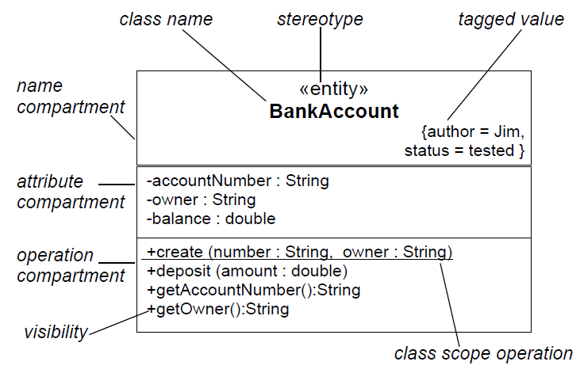
UML Class Notation

Slide 3
Class extraction
The Unified Process does not describe how classes are extracted
Users of the Unified Process are expected to have a background in object-oriented analysis and design
Let us now explain how classes are extracted, and then return to the structural modelling

Slide 4
Extracting Entity Classes
Entity class extraction consists of three steps that are carried out iteratively and incrementally:
Behavioral/Functional modeling
Present scenarios of all the use cases (a scenario is an instance of a use case)
Class modeling
Determine the entity classes and their attributes
Determine the interrelationships and interactions between the entity classes
Present this information in the form of a class diagram
Dynamic modeling
Determine the operations performed by or to each entity class
Present this information in the form of a statechart

Slide 5
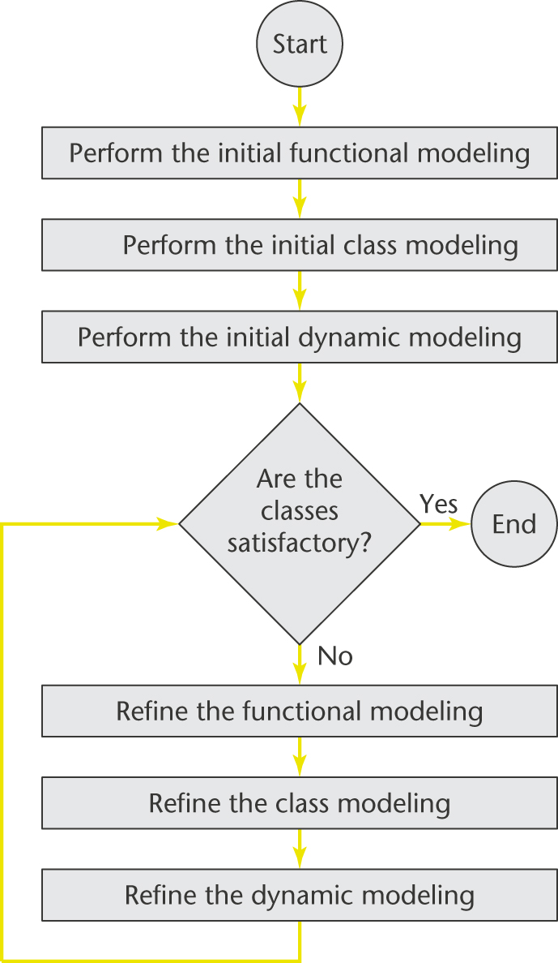
Flowchart for Extracting Entity Classes

Slide 6
Initial Class Diagram: Painting System Case Study
The second step in extracting the entity classes is class modeling
The aim of this step is to extract the entity classes, determine their interrelationships, and find their attributes
Usually, the best way to begin this step is to use the two-stage noun extraction method
Stage 1: Describe the information system in a single paragraph
Stage 2: Identify the nouns in this paragraph, then select the entity classes from those nouns

Slide 7
Noun Extraction: Painting System Case Study
Stage 1: Describe the information system in one paragraph:
Reports are to be generated in order to improve the effectiveness of the decision-making process for buying works of art. The reports contain buying and selling information about paintings, which are classified as masterpieces, masterworks, and other paintings

Slide 8
Noun Extraction: Painting System (contd)
Stage 2: Identify the nouns in this paragraph
Reports are to be generated in order to improve the effectiveness of the decision-making process for buying works of art. The reports contain buying and selling information about paintings, which are classified as masterpieces, masterworks, and other paintings
The nouns are report, effectiveness, process, buying, work of art, selling, information, painting, masterpiece, and masterwork

Slide 9
Noun Extraction: Painting System (contd)
effectiveness, process and information are abstract nouns and are therefore unlikely to be entity classes
Abstract nouns identify things that have no physical existence
Nouns buying and selling are derived from the verbs “buy” and “sell”
They will probably be operations of some class

Slide 10
Noun Extraction: Painting System (contd)
Noun report is unlikely to be an entity class, because a report is not long lived
A report is much more likely to be a boundary class
Noun work of art is just a synonym for painting

Slide 11
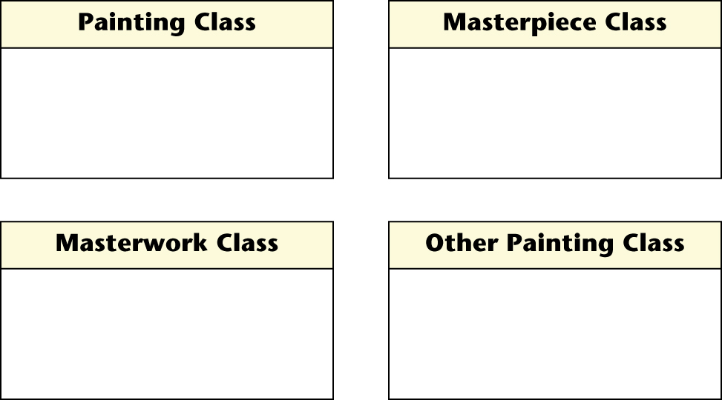
First Iteration of the Initial Class Diagram
This leaves four candidate entity classes:
Painting Class, Masterpiece Class, Masterwork Class, and Other Painting Class

Slide 12
Second Iteration of the Initial Class Diagram
Consider the interrelationships between the entity classes
A masterpiece is a specific type of painting, and so is a masterwork and an “other painting”
Painting Class is therefore the base class
Masterpiece Class, Masterwork Class, and Other Painting Class are subclasses of that base class

Slide 13
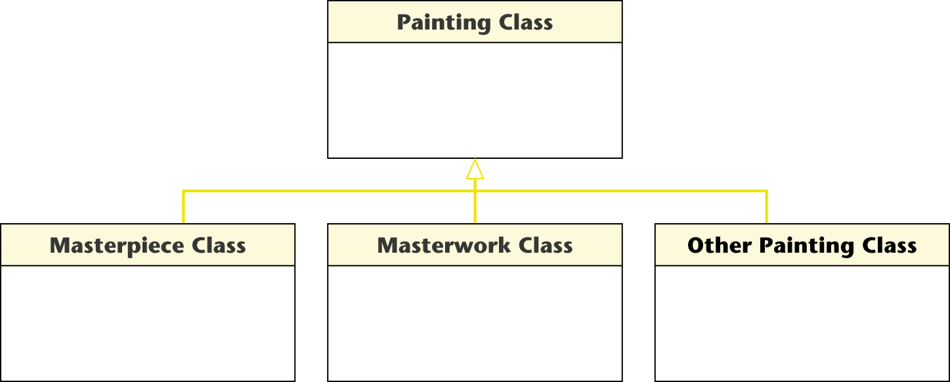
Second Iteration of Initial Class Diagram (contd)

Slide 14
Third Iteration of the Initial Class Diagram
The class diagram does not reflect aspects of the pricing algorithm
When dealing with a masterwork
“The information system first computes the maximum purchase price as if it were a masterpiece by the same artist”

Slide 15
Third Iteration of the Initial Class Diagram (contd)
That is, a masterwork has to have all the attributes of a masterpiece (so that its maximum purchase price can be computed as if it were a masterpiece) and, in addition, it may have attributes of its own
This is modeled in the next slide

Slide 16
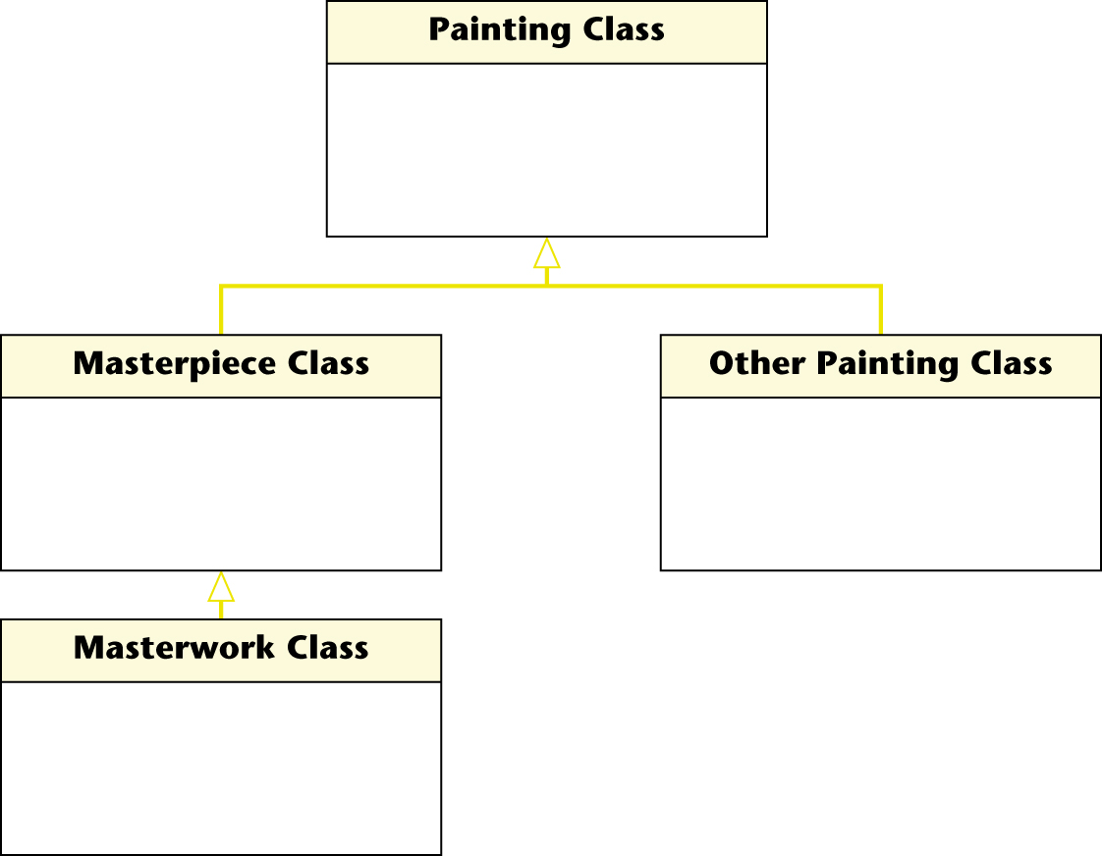
Third Iteration of the Initial Class Diagram (contd)

Slide 17
Fourth Iteration of the Initial Class Diagram
Another aspect of the pricing algorithm that is not reflected in the current class diagram is
“The information system computes the coefficient of similarity between each painting for which there is an auction record and the painting under consideration for purchase”

Slide 18
Fourth Iteration of the Initial Class Diagram (contd)
Auctioned Painting Class is needed to make these comparisons
An auctioned painting must be a subclass of Painting Class
But a painting previously been sold at an auction somewhere in the world has nothing to do with paintings currently on display for sale in Osbert’s gallery

Slide 19
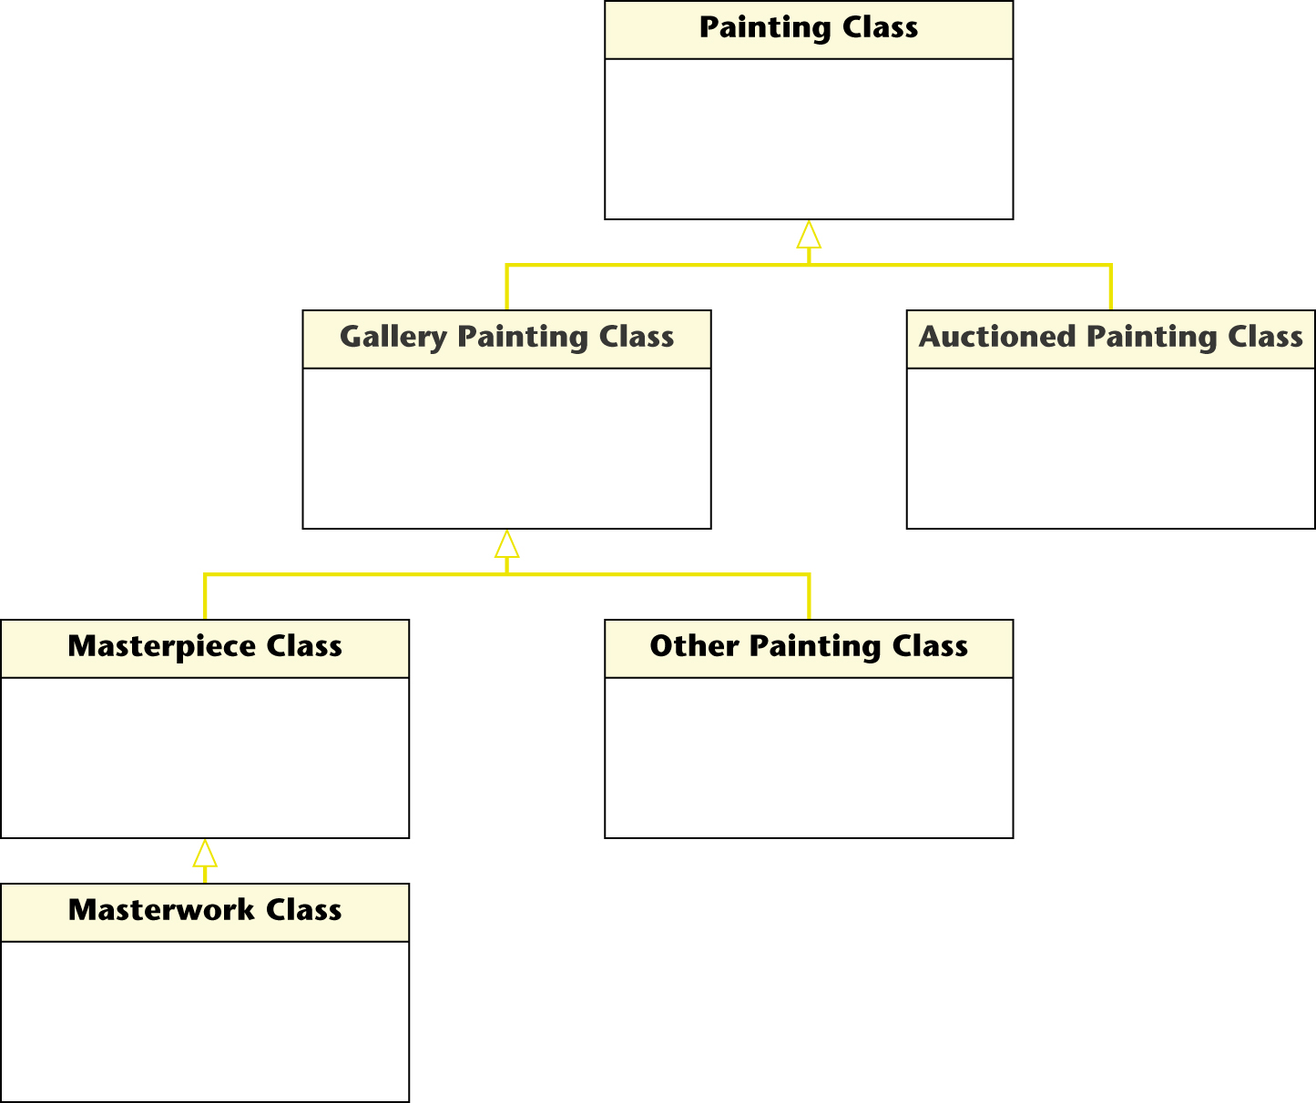
Fourth Iteration of the Initial Class Diagram (contd)

Slide 20
Fourth Iteration of the Initial Class Diagram (contd)
An instance of Painting Class is either
A painting that Osbert has bought (an instance of Gallery Painting Class), or
A painting sold at some auction (an instance of Auctioned Painting Class)

Slide 21
Initial Class Diagram: Painting System Case Study
Why was the first iteration of the class diagram so inadequate?
The Painting System case study appears to be a straightforward data-processing application
The one-paragraph description correctly did not incorporate the pricing algorithm
Unfortunately, the algorithmic details turned out to be critical to the class diagram

Slide 22
Initial Class Diagram: Painting System (contd)
The first iteration of the class diagram was no good
However, repeated iteration and incrementation led to a reasonable class diagram
This demonstrates the power of the iterative and incremental approach

Slide 23
Initial Class Diagram (contd)
Finally, we add the attributes of each class to the class diagram
the result is shown on the next slide
The empty rectangle at the bottom of each box will later be filled with the operations of that class

Slide 24
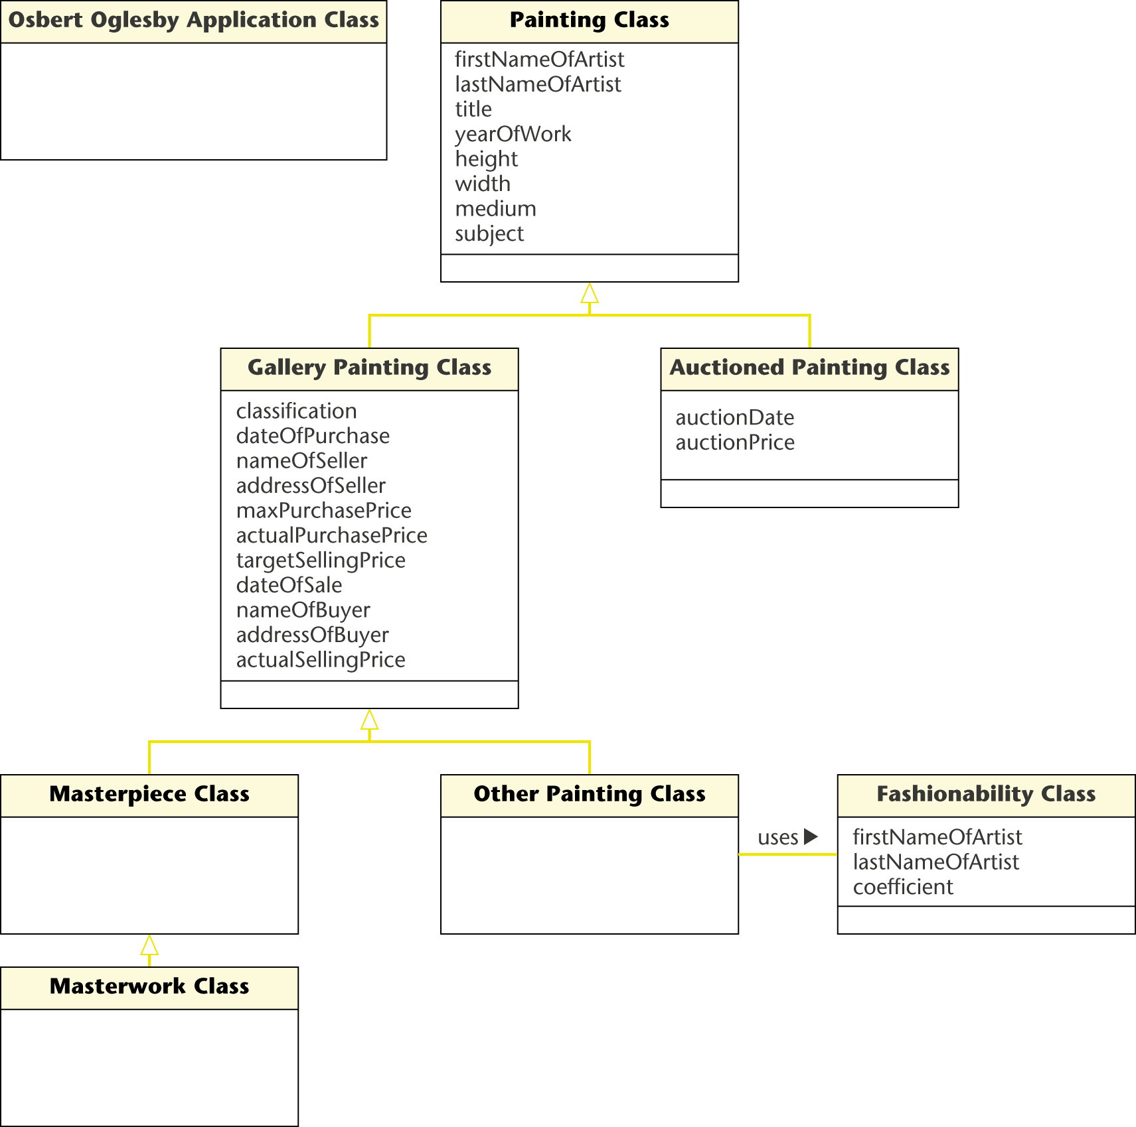
Fifth Iteration of the Initial Class Diagram (contd)

Slide 25
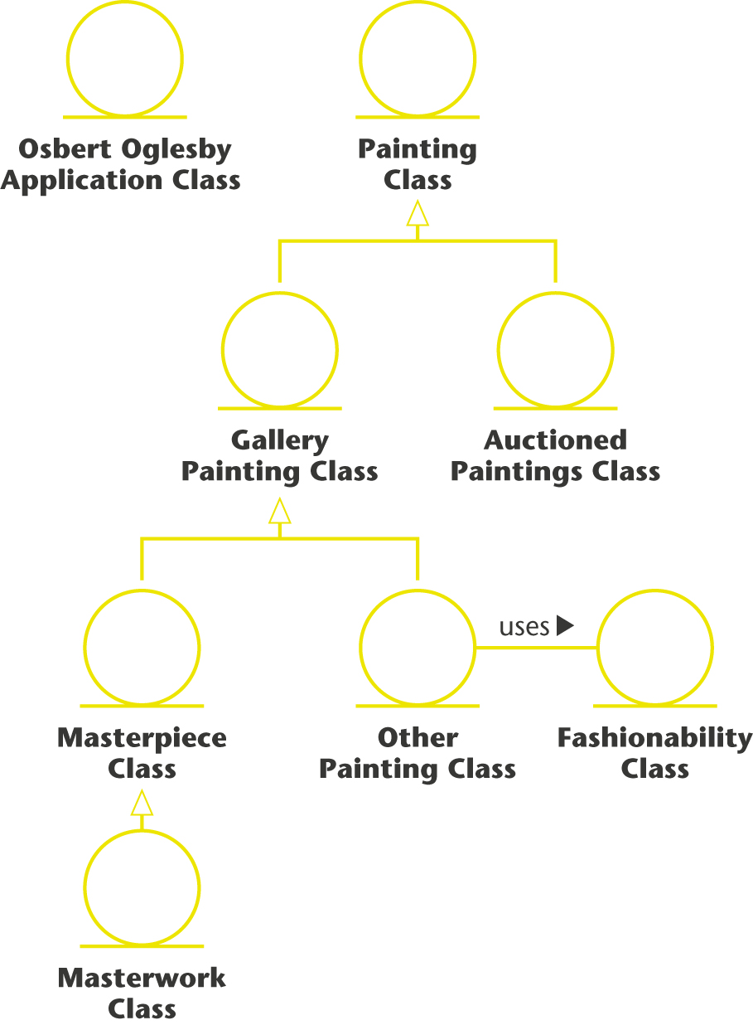
Fifth Iteration of the Initial Class Diagram (contd)

Slide 26
Done with the Painting System case study
Still the dynamic modeling – later

